Slide 1

Mockito
Mockito is an open source testing framework for Java released under the MIT License. The framework allows the creation of test double objects in automated unit tests for the purpose of test-driven development or behavior-driven development.

Slide 2
Stub
A stub interface simulates an actual object by using a few methods. It's an object with pre-existing data that delivers a constant value regardless of input. You can utilize it when the test suite is simple and hard-coded values aren't an issue. Both developers and testers also use it. However, you cannot share it due to compatibility issues caused by hard-coding of resources, deployment dependencies, and platforms.
You can also use the stub for Hypertext Transfer Protocol (HTTP) communication, which some refer to as a virtual service. Furthermore, it can be used to match database objects. In other words, a stub can be used as a dummy module to test an application while the actual module is being developed. Furthermore, the stub alleviates any issues that may arise during the implementation of the actual object.

Slide 3
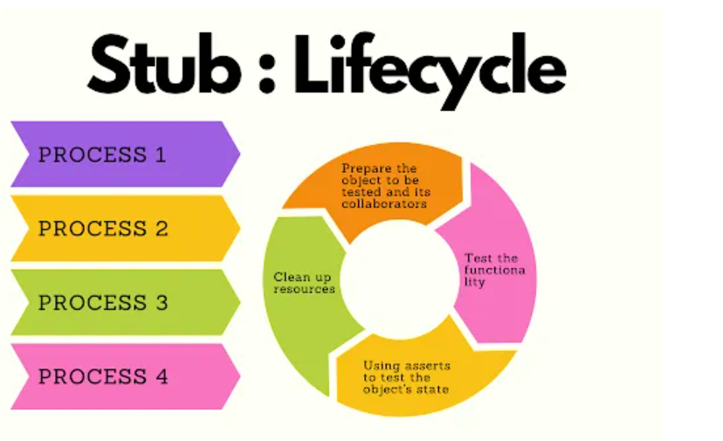

Slide 4
Mock
Mock is an interface that we program to compare the outputs from the tests to the expected outcomes. You can frequently use third-party libraries such as Mockito and JMock to accomplish this. It also comes in handy when you have an extensive test suite, and each test demands a different set of data.
Maintaining a stub becomes too expensive in this situation. A mock allows the test to keep its data configuration. Both developers and testers can also use it. However, due to compatibility issues arising from hard-coding of resources, deployment dependencies, and platforms, you cannot share it with a larger community.
A mock can also track how many times we call a method, function, or object and the order of calls. It also monitors communication between classes. For mocking reasons, we can utilize the method ‘mock()’.

Slide 5
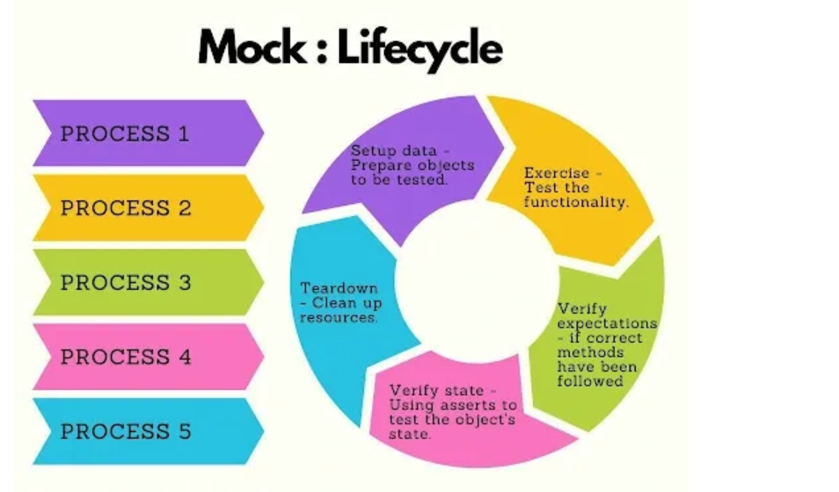

Slide 6
// @RunWith attaches a runner with the test class to initialize the test data
@RunWith(MockitoJUnitRunner.class) public class MathApplicationTester {
private MathApplication mathApplication; private CalculatorService calcService;
@Before public void setUp(){ mathApplication = new MathApplication();
calcService = mock(CalculatorService.class); mathApplication.setCalculatorService(calcService); }
@Test public void testAddAndSubtract()
{ //add the behavior to add numbers when(calcService.add(20.0,10.0)).thenReturn(30.0);
//subtract the behavior to subtract numbers when(calcService.subtract(20.0,10.0)).thenReturn(10.0);
//test the subtract functionality Assert.assertEquals(mathApplication.subtract(20.0, 10.0),10.0,0);
//test the add functionality Assert.assertEquals(mathApplication.add(20.0, 10.0),30.0,0);
//verify call to calcService is made or not verify(calcService).add(20.0,10.0); verify(calcService).subtract(20.0,10.0); } }

Slide 7
Tester class
import org.junit.runner.JUnitCore; import org.junit.runner.Result;
import org.junit.runner.notification.Failure;
public class TestRunner { public static void main(String[] args)
{ Result result = JUnitCore.runClasses(MathApplicationTester.class);
for (Failure failure : result.getFailures()) {
System.out.println(failure.toString());
}
System.out.println(result.wasSuccessful());
}
}

Slide 8
Basic Steps of Mocking:
Step 1 : Setting up an example using http://start.spring.io.
Step 2 : Using a Stubs – Disadvantages
How can I get DataServiceStub to return various data depending on the situation?
The DataServiceStub implementations should be updated whenever the DataService interface is changed with new methods.
Step 3 : Your first mock.
Step 4 : Using Mockito Annotations - @Mock, @InjectMocks, @RunWith(MockitoJUnitRunner.class)
Step 5 : Mocking List interface

Slide 9
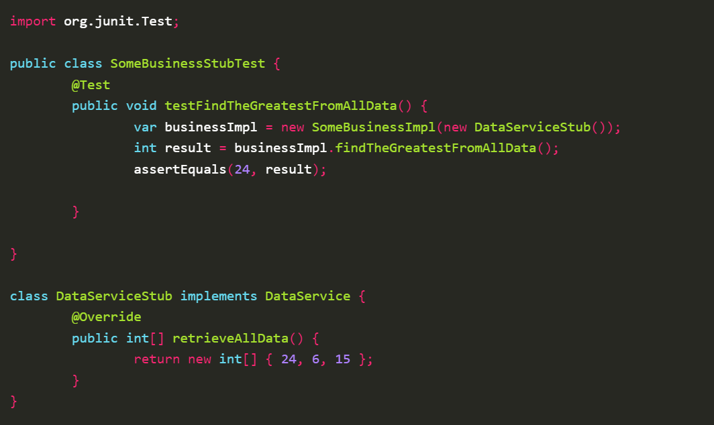
Using a stub

Slide 10
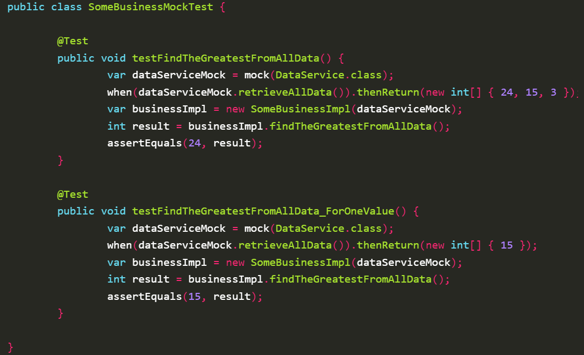
Your first Mock

Slide 11
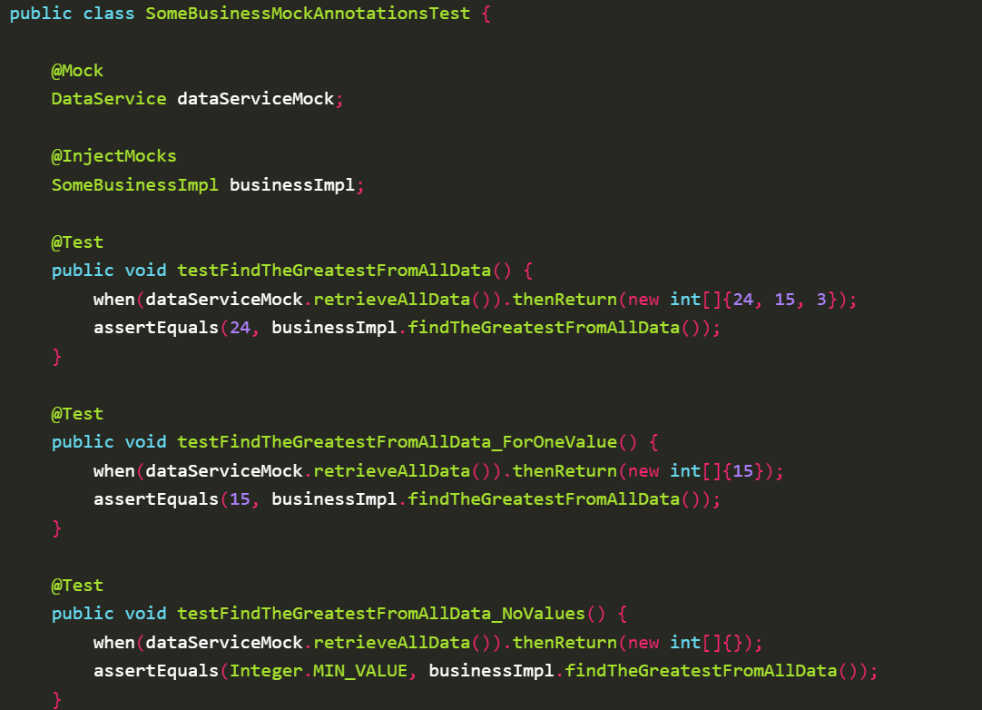
Using Mockito Annotations

Slide 12
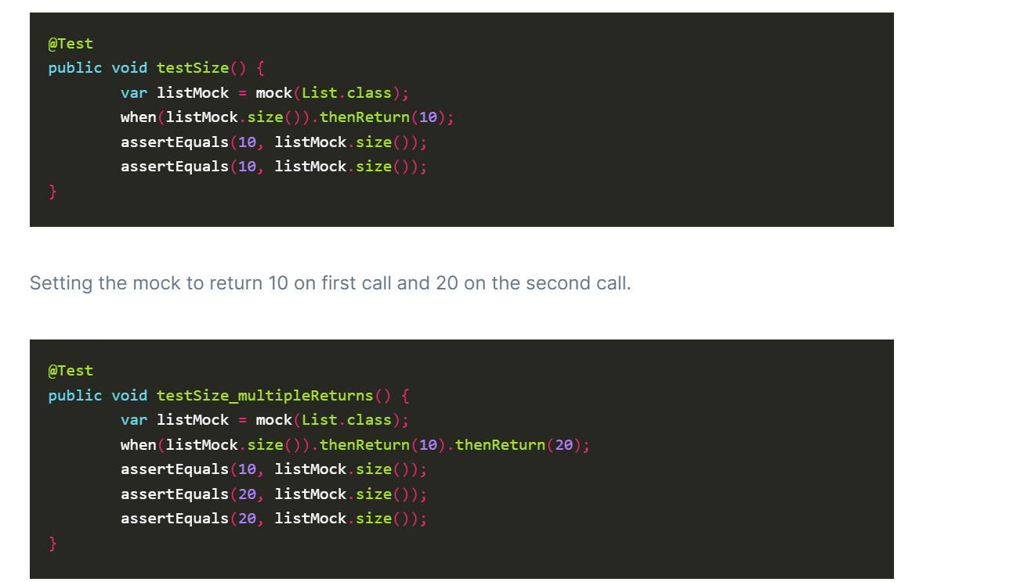
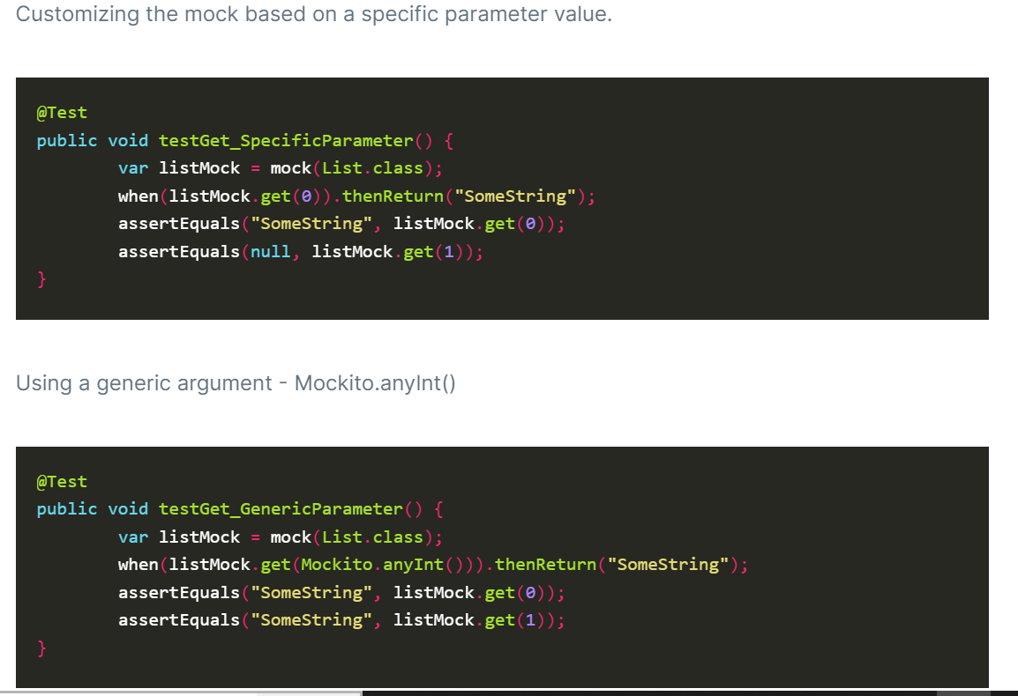
Mocking List Interface

Slide 13
Reasons why we use Mockito
Manage code Quality Variability
Organized and Effective Unit Testing
Object Isolation
Confirm Design Options before Coding
Supports TDD or Early Testing
Supports Testing of Backend Operations

Slide 14
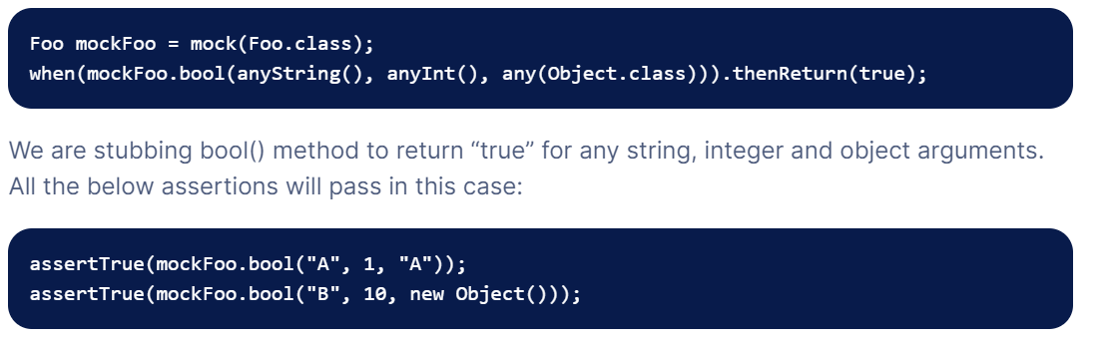
Mockito Argument Matcher any()

Slide 15
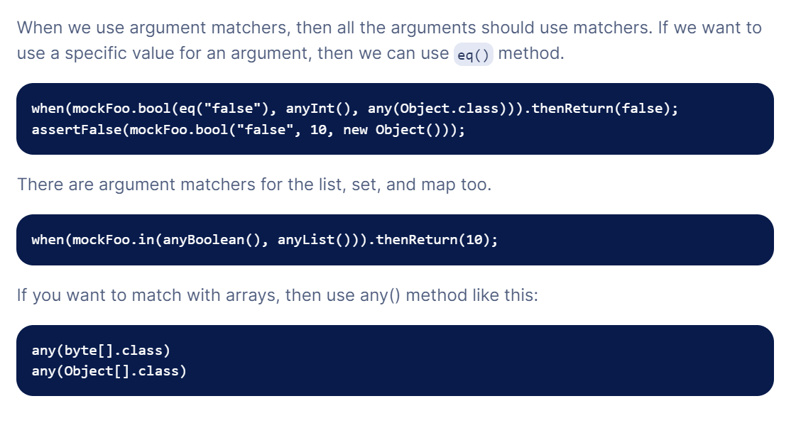
Eq()

Slide 16
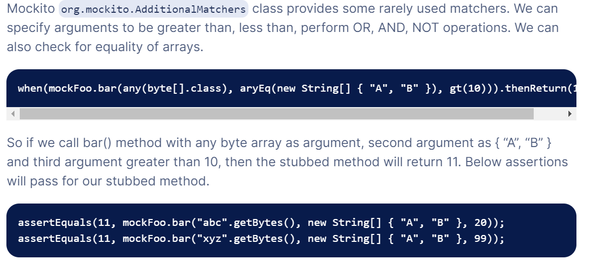
Additional Matchers

Slide 17
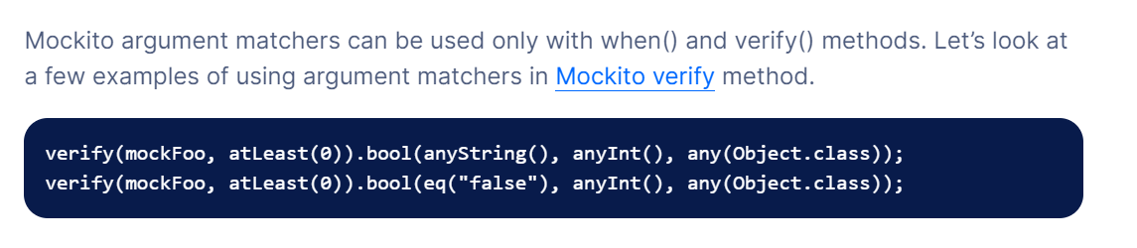
Verify Argument Matchers

